Slide 1
Library System
System Request
Team Alexandria
Alexander Cha(Scrum Master), Amit Dsouza(Business Analyst), Jason Spriggs(Product Owner), Mehak Chadha(Business Analyst), Omar Chaudhry(Business Analyst)

Slide 2

Business Need
Project aims to provide electronic means to manage library operations
Current system inefficiencies:
  Requires multiple employees for inventory system
  No outside access to library resources to users
Notes:
Alex

Slide 3
Business Requirements
Employee access:
  Update, track and search inventory
  Add new forms of media
Customers can search database instead of physically searching
System operations:
  Interlibrary media rentals
  Online access to PDF resource, databases, articles, etc
Notes:
Alex

Slide 4

Business Value
Increase daily productivity of employees
Increases in library media usage
Expected(tangible) revenue increases:
  Online video rental: $25,000
  PDF and ebooks: $10,000
  Store rentals: $5,000
  Downsizing: $90,000
Notes:
Alex

Slide 5
Special Issues and Constraints
Updating system is far overdue and should be implemented ASAP
System will take time to develop and integrate into the legacy system
Training needed
Stakeholders need to be informed and consulted with
Potential resistance from current customers
Notes:
Amit

Slide 6
System Request
Business benefits
New System will provide new avenue of revenue
Allows online access to library resources
Enables interlibrary rentals
  Common system used in multiple branches
Reduced staff requirement
Improved work environment
Online search capabilities improves customer and employee satisfaction
Reduced physical labor, error and stress
More efficient work environment
Notes:
Amit

Slide 7

Technical Feasibility: Can We Build it?
Hardware Requirements
4TB SSD, 2TB Hard Drive, Processor, Colored Monitor, Keyboard, and Mouse
Software Requirement
Windows, MacOS, GitHub and SQL Developer
Notes:
Omar

Slide 8

Economic Feasibility: Should We Build it?
Costs
Development Costs: Development team salaries, Training, Hardware, and Software.
Operational Costs: Software upgrades, Cloud storage fees, Operational team salaries, and User training.
Benefits
Tangible Benefits: Increased Sales, and Reductions in Staff, Reduced Inventory Costs.
Intangible Benefits: Brand recognition, Higher quality system, Improved customer service, and supplier relations.
Notes:
Mehak

Slide 9
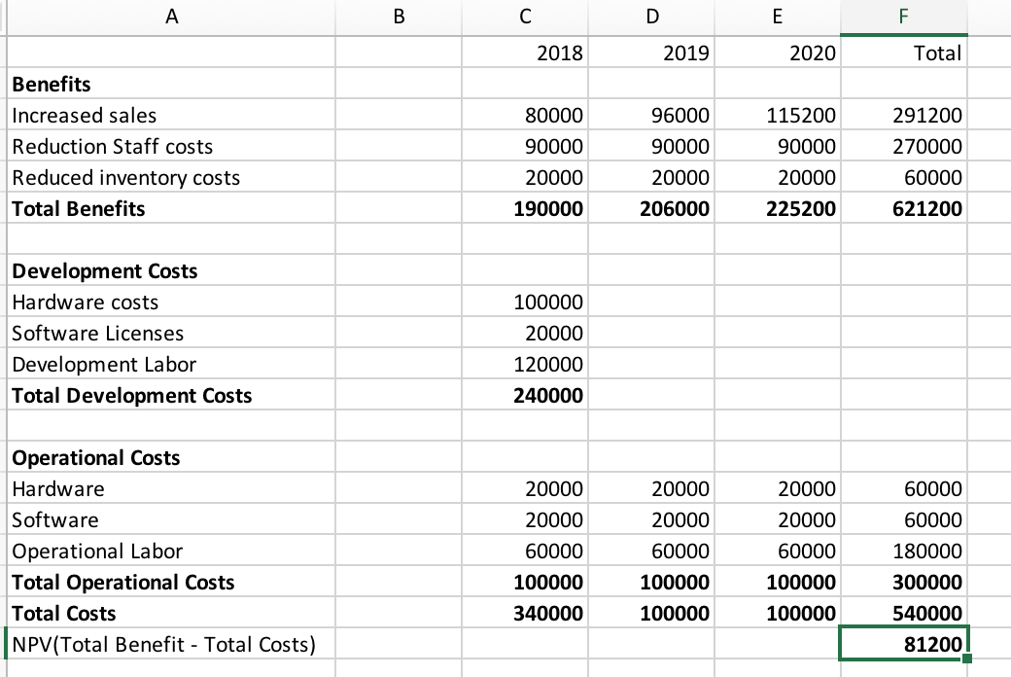
Cost-Benefit Analysis
Notes:
Mehak

Slide 10

Organizational Feasibility
Library Management System will provides “better and efficient” service to members.
Data Security
Provide faculty for proper monitoring reduce paper work.
Reduce redundancy in the information required from the customers in order for them to find media, create user accounts.
Notes:
Jason

Slide 11
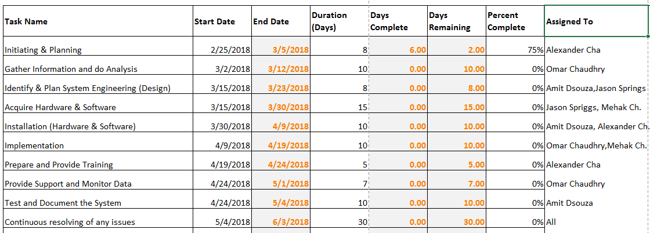
Project Work Plan
Notes:
Omar

Slide 12

Team Structure + Project Methodology
Agile Scrum Team Benefits:
Quick MVP
Consistent Iteration and Bug Fixes
Minimal Overhead
Product Owner: Jason
Scrum Master: Alex
Notes:
Jason

Slide 13
Thank You!

